Slide 1
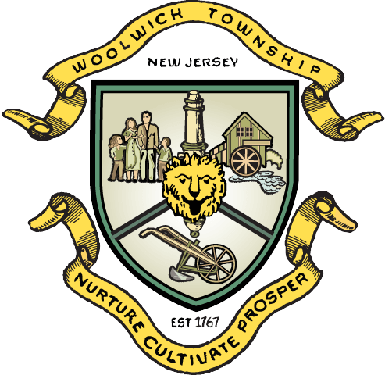
Master Plan Re-Examination

Slide 2
Table of Contents
Master Plan Re-examination
Basic Rezoning Process
Clustering: A New Tool for Guiding Growth
Conventional Lotting
Cluster Development
Clustering Bonus Density
Buildout Example Comparison
Existing and Proposed Zoning*
*Mapping and presentation displayed during the 10/20 session will be available to the public.

Slide 3
Master Plan Re-examination
The Master Plan Reexamination is just a plan.
It sets the proposed vision for future development in the Township.
It gives recommendations to the Governing Body on proposed zoning.
It does NOT change the zoning.

Slide 4
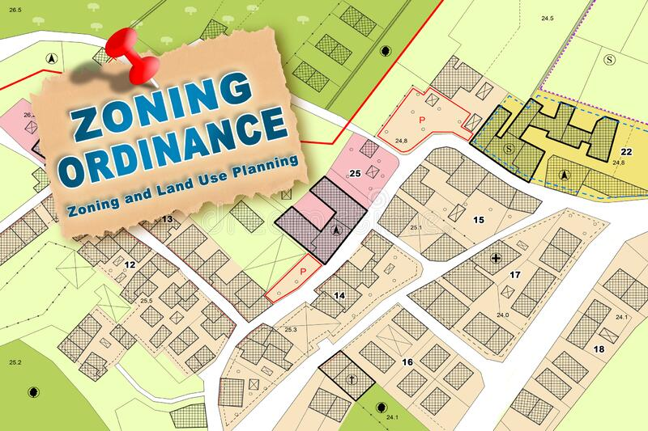
Basic Rezoning Process
To change the zoning, the Township Committee must adopt an Ordinance.
Following Ordinance introduction, the proposed Ordinance is sent to the JLUB for review.
The Township Committee will review the recommendations of the JLUB and deny, amend or adopt the Ordinance.
Upon adoption of the Ordinance, the zoning map is revised, and the Ordinance becomes the new zoning.

Slide 5
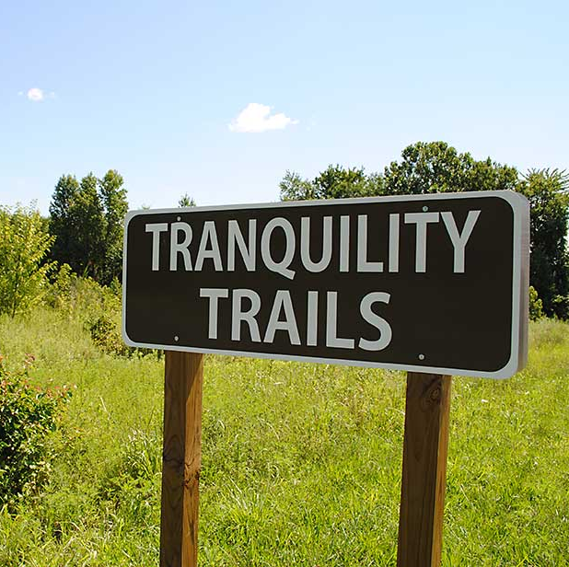
Clustering: A New Tool for Guiding Growth
Locates development where it makes sense
Achieves land conservation through private funding
Protects environmentally sensitive areas
Lower infrastructure costs due to consolidated development
Notes:
Additional opportunities to provide bonus density where a certain percentage of the tract is preserved, or a certain tract acreage is achieved to support conservation while also providing additional landowner options.

Slide 6
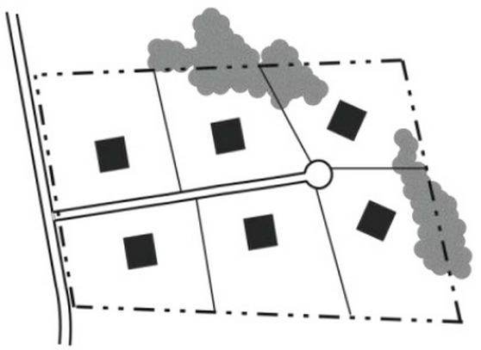
Conventional Development
“Large Lot Zoning”
Uniform Lot Sizes
Development covers most, or all, of the site
Notes:
Conventional development is your most basic idea of a subdivision. A developer divides the total parcel of land by the prescribed zoning density for that area to yield a total number of lots, all equal in size. Often, large minimum lot sizes are used in an attempt to limit development impacts. This is sometimes referred to as “large lot zoning.”

Slide 7
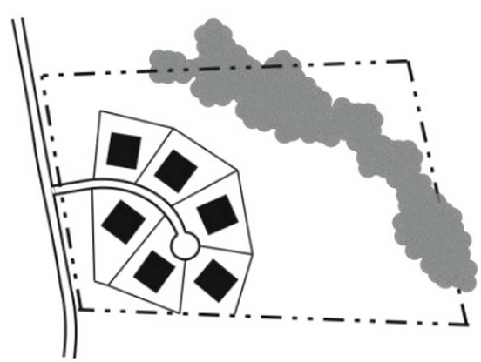
Contiguous Cluster Development
Development is concentrated on a portion of the site
Remaining land is permanently preserved as open space or farmland
*add comment regarding less infrastructure*
Notes:
The contiguous cluster development has been used as a way to permit development while also preserving land for open space or farmland. Number of units is the same or similar to that of a conventional development, but each lot will be smaller in size. This permanently preserves land or open space without public funding.

Slide 8
Concept Bonus Density for Tract Size & Additional Land Preservation
Tract Size (proposed) * | Bonus Units (proposed)
>25 acres | 10%
>50 acres | 15%
>75 acres | 20%
>100 acres | 25%
Open Space Preserved (proposed) | Bonus Units (proposed)
30% | 20%
40% | 30%
50% | 40%
60% | 50%
*Bonus based on overall tract acreage.
Notes:
*This will be part of the ordinances once adopted by Township committee.

Slide 9
Buildout/Yield Example: 100-acre parcel
Assumptions: 20% of tract set aside for infrastructure such as roads, sidewalks, stormwater management, etc. 10% for clustering
Additional consideration will be given to inclusion of stormwater management facilities in open space calculations, increasing the potential number of dwelling units
Regulation | Density | Total Number of Units | Preserved Land
Current Zoning (TDR) | 1 unit per 15 acres | 6 units | 0 acres
5A with Clustering (1 unit/3 ac.) | 1 unit per 3 acres | 22-31 units | 30-60% of overall tract
R-1 zoning (1 unit/2 ac.) | 1 unit per 2 acres | 40 units | 0 acres
Notes:
With an assumption bonus density of X% and preservation of tract of X%,

Slide 10
Existing Zoning
In all, there have been approximately 1,704 acres of farmland preserved within the Township through the traditional farmland preservation program.
Note: Kings Landing Redevelopment Plan Zoning is not accurately depicted on this zoning map.
Notes:
Compared to 851 acres through the $5,000,000 grant and 30.65 acres by private TDR transactions.

Slide 11
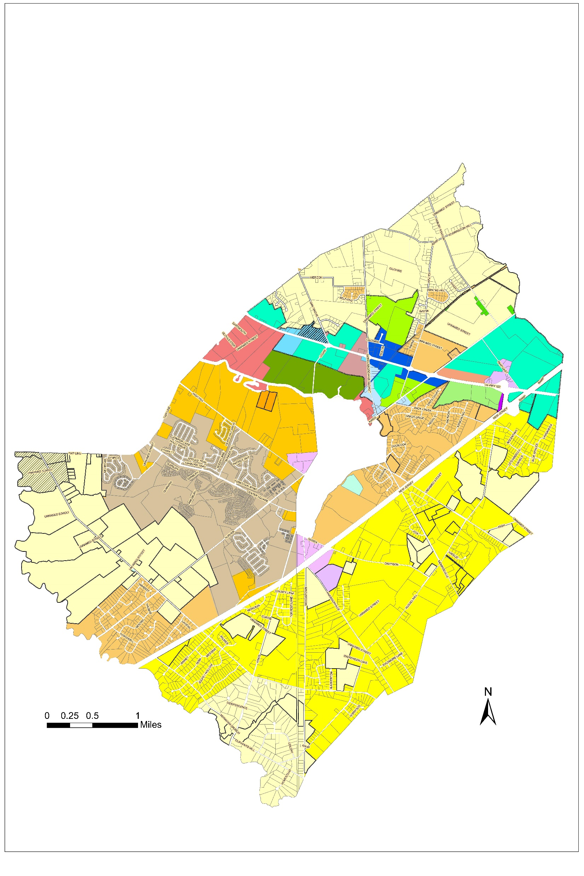
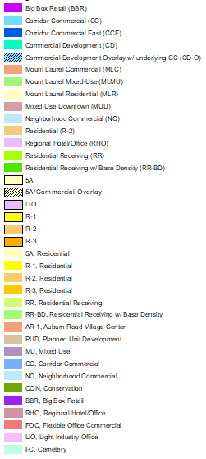
Rezoning Recommendations

Slide 12
Thank you for your time

